Slide 1
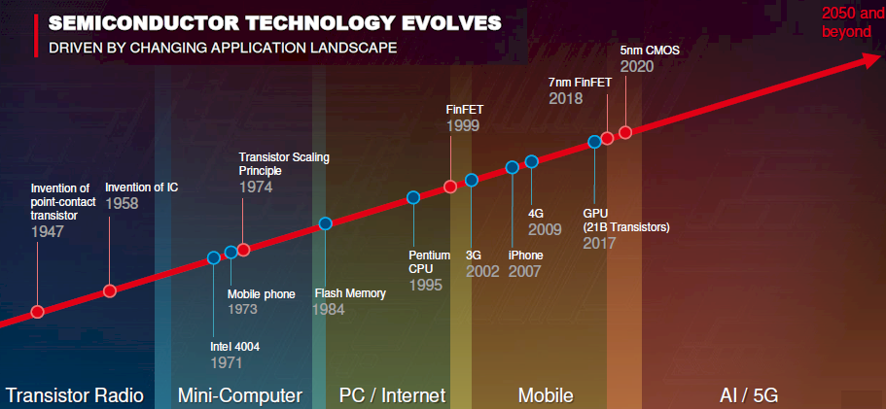
Module 2
Performance Evaluation of Computer Systems

Slide 2
Content
Evaluation Parameters
Quantitative Principals: Amdahl’s Law

Slide 3
A Computer System
Computer systems consist of:
  Processor
  Memory
  Input/Output
  Operating system
  Network
Memory
instruction
data
Input unit
Output unit
Processor
P
P
P
P
Network

Slide 4
Performance Factors
Performance depends on:
  Technology
  Instruction Set Architecture
  Organization
  Software

Slide 5
Technology
In recent years, microprocessors have become smaller and denser.

Slide 6
Technology
 | 1945 | 2020
Computer | ENIAC | Laptop
Devices | 18 000 | 17 000 000 000
Weight (kg) | 27 200 | 1.5
Size (m³) | 68 | 0.0018
Power (watts) | 20 000 | 5.5
Cost ($) | 4 630 000 | 1 000
Memory (bytes) | 200 | 160 000 000 000
Performance (Flops/s) | 800 | 3 000 000 000

Slide 7
Performance Units
Speed
1 Mflop/s 1 Megaflop/s 10⁶ Flop/second
1 Gflop/s 1 Gigaflop/s 10⁹ Flop/second
1 Tflop/s 1 Teraflop/s 10¹² Flop/second
1 Pflop/s 1 Petaflop/s 10¹⁵ Flop/second
1 Eflop/s 1 Exaflop/s 10¹⁸ Flop/second
Storage
1 MB 1 Megabyte 10⁶ Bytes
1 GB 1 Gigabyte 10⁹ Bytes
1 TB 1 Terabyte 10¹² Bytes
1 PB 1 Petabyte 10¹⁵ Bytes

Slide 8
Performance Evaluation of Computer Systems
Performance depends on:
  Technology
  Instruction Set Architecture
  Organization
  Software

Slide 9
Instruction Set Architecture-ISA
Instruction Set Design:
RISC / CISC
  Code density
Number of operands
  Stack machines (0-operand)
  Accumulator machines (1-operand)
  Register machines (2-operand, 3-operand)

Slide 10
RISC VS CISC
CISC | RISC
CISC architecture gives more importance to hardware | RISC architecture gives more importance to software
Multiple Instruction sizes and formats | Instruction of same size with few formats
Less registers | Uses more registers
More addressing modes | Fewer addressing modes
Extensive use of microprogramming | Complexity in compiler
Instructions take varying amount of cycle time | Instructions take one cycle time
Pipelining is difficult | Pipelining is easy

Slide 11
Performance Evaluation of Computer Systems
Performance depends on:
  Technology
  Instruction Set Architecture
  Organization
  Software

Slide 12
Organization
Memory Hierarchy
CPU
Registers
L1 Cache
Hierarchy | Speed | Size
Within the processor (CPU-registers-on chip cache) | 1 ns | Byte
L2 cache (SRAM) | 10 ns | KByte
Main Memory (DRAM) | 100 ns | MByte
Secondary storage (Disk) | 10 ms | Gbyte
Tertiary Storage (Tape/Disk) | 10 s | TByte
L2 Cache
Main Memory
Disk
Tape

Slide 13
Organization
Multicore Chips
Single-core Dual-core
CPU
CPU
CPU
Registers
Registers
Registers
L1 Cache
L1 Cache
L1 Cache
L2 Cache
L2 Cache
Main Memory
Main Memory

Slide 14
Performance Evaluation of Computer Systems
Performance depends on:
  Technology
  Instruction Set Architecture
  Organization
  Software

Slide 15
EVALUATION PARAMETERS [3]
Performance Evaluation of Computer Systems

Slide 16
The Questions are..
  How to compare performance of two different machines?
  What factors affect performance?
  How to improve performance?

Slide 17
Defining Performance [ 4]
If you were running a program on two different desktop computers, you’d say that the faster one is the desktop computer that gets the job done first.
If you were running a datacenter that had several servers running jobs submitted by many users, you’d say that the faster computer was the one that completed the most jobs during a day.
As an individual computer user, you are interested in reducing response time—the time between the start and completion of a task—also referred to as execution time.
Datacenter managers are often interested in increasing throughput or bandwidth—the total amount of work done in a given time.
Hence, in most cases, we will need different performance metrics

Slide 18
Response Time
  the time between the start and completion of a task also referred to as execution time.
Throughput
  The total amount of work done in a given time.
  Decreasing response time almost always improves throughput.

Slide 19
To maximize performance, we want to minimize response time or execution time for some task. Thus, we can relate performance and execution time for a computer X:
Performance_{X} = 1/ Execution time_{X}
This means that for two computers X and Y, if the performance of X is greater than the performance of Y, we have
Performance_{x} > Performance_{y}
1/ Execution time_{x} > 1/Execution time_{y}
Execution time_{Y} > Execution time_{X}
That is, the execution time on Y is longer than that on X, if X is faster than Y.

Slide 20
we oft en want to relate the performance of two different computers quantitatively. We will use the phrase “X is n times faster than Y”—or equivalently “X is n times as fast as Y”—to mean
Performance_{x} / Performance_{y} = n
If X is n times as fast as Y, then the execution time on Y is n times as long as it is
on X:
Performance_{x} / Performance_{y} = Execution time_{y}/ Execution time_{x}=n = Speedup

Slide 21
If computer A runs a program in 10 seconds and computer B runs the same program in 15 seconds, how much faster is A than B?
We know that A is n times as fast as B if
Performance_{A} / Performance_{B} = Execution time_{B}/ Execution time_{A}=n
Thus the performance ratio is
15 / 10 = 1.5
A is therefore 1.5 times as fast as B.
In the above example, we could also say that computer B is 1.5 times slower than
computer A, since
Performance_{A} / Performance_{B} = 1.5
Performance_{A} = 1.5 * Performance _{B}

Slide 22
CPU Performance Its Factors[4]
Execution time depends on Clock Cycle time
CPU execution time = CPU clock cycles for a program * Clock cycle Time
Clock Cycle time= 1 / Clock rate,
So,
CPU execution time for a program = CPU clock cycles for a program /Clock rate
Example :
Our favorite program runs in 10 seconds on computer A, which has a 2 GHz clock. We are trying to help a computer designer build a computer, B, which will run this program in 6 seconds. The designer has determined that a substantial increase in the clock rate is possible, but this increase will affect the rest of the CPU design, causing computer B to require 1.2 times as many clock cycles as computer A for this program. What clock rate should we tell the designer to target?
Clock cycle
cycle 1
cycle 2
cycle 3

Slide 23
Solution
Clock cycle_{A} = Execution Time_{A} * Clock Rate
= 10 sec* 2*10^9 cycle/ sec =20*10^9 cycle
Clock Cycle_{B}= 1.2 * Clock cycle_{A}
= 24 * 10^9 cycle
Clock Rate_{B} = Clock Cycle_{B} / Execution time_{B}
= 24 * 10^9 cycle / 6 sec
= 4 *10^9 cycle / sec = 4GHz

Slide 24
The CPU clock cycle required for a program can be define as,
CPU clock cycles for a program= Instructions for a program * Average clock cycles per instruction
Average Clock cycle per Instruction-
Defined as average number of clock taken by each instruction. Which is also known as CPI.
Different instructions may take different times for execution , the CPI is the average of all instructions executed in the program.

Slide 25
Example
Suppose we have two implementations of the same instruction set architecture. Computer A has a clock cycle time of 250ps and a CPI of 2.0 for some program, and computer B has a clock cycle time of 500ps and a CPI of 1.2 for the same program. Which computer is faster for this program and by how much?.

Slide 26
CPU clock cycles_{A} = I* 2.0
CPU clock cycle_{B} = I* 1.2
CUP time_{A} = CPU clock cycle_{A} * Clock cycle time
= I * 2.0 * 250 ps = 500 * I ps
CPU time _{B} = I * 1.2 * 500 ps = 600 * I ps
CPU performance_{A} / CPU performance_{B}= Execution time_{B} / Execution time_{A}
= 600 *I ps / 500* I ps =1.2
So A is 1.2 times as fast as B .

Slide 27
Now we can write CPU execution time as,
CPU time = Instruction count * CPI * Clock cycle time
CPU time = ( Instruction count * CPI ) / Clock rate

Slide 28
CPU Execution Time: Example
A Program is running on a specific machine (CPU) with the following parameters:
  Total executed instruction count: 10,000,000 instructions
  Average CPI for the program: 2.5 cycles/instruction.
  CPU clock rate: 200 MHz.
What is the execution time for this program??
CPU time = Instruction count x CPI x Clock cycle Time
= 10,000,000 x 2.5 x 1 / clock rate
= 10,000,000 x 2.5 x 5x10⁻⁹
= 0.125 seconds
T = I x CPI x C

Slide 29
Aspects of CPU Execution Time
CPU Time = Instruction count executed x CPI x Clock cycle
T = I x CPI x C
Depends on:
Program Used
Compiler
ISA
Instruction Count I
(executed)
Depends on:
Program Used
Compiler
ISA
CPU Organization
Depends on:
CPU Organization
Technology (VLSI)
CPI
Clock
Cycle
C
(Average
CPI)

Slide 30
Factors Affecting CPU Performance
T = I x CPI x C
Instruction
Count
Cycles per
Instruction
Clock Rate
(1/C)
Program
Compiler
Instruction Set
Architecture (ISA)
Organization
(CPU Design)
Technology
(VLSI)
T = I x CPI x C

Slide 31
Performance Comparison: Example
A Program is running on a specific machine (CPU) with the following parameters:
  Total executed instruction count, I: 10,000,000 instructions
  Average CPI for the program: 2.5 cycles/instruction.
  CPU clock rate: 200 MHz.
Using the same program with these changes:
  A new compiler used: New executed instruction count, I: 9,500,000
  New CPI: 3.0
  Faster CPU implementation: New clock rate = 300 MHz
What is the speedup with the changes?
Speedup = (10,000,000 x 2.5 x 5x10⁻⁹) / (9,500,000 x 3 x 3.33x10⁻⁹ )
= .125 / .095 = 1.32
or 32 % faster after changes.
Thus: C = 1/(200x10⁶)= 5x10⁻⁹ seconds
Speedup = Old Execution Time = I_{old} x CPI_{old} x Clock cycle_{old}
New Execution Time I_{new} x CPI_{new} x Clock Cycle_{new}
Clock Cycle = C = 1/ Clock Rate
T = I x CPI x C

Slide 32
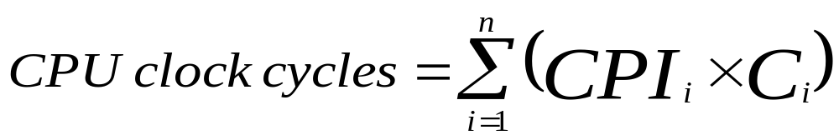
Instruction Types & CPI
Given a program with n types or classes of instructions executed on a given CPU with the following characteristics:
  C_{i} = Count of instructions of type_{i}
  CPI_{i} = Cycles per instruction for type_{i}
Then:
CPI = CPU Clock Cycles / Instruction Count I
  Where:
  Executed Instruction Count I = Σ C_{i}
i = 1, 2, …. n
Depends on CPU Design
i.e average or effective CPI
Executed
T = I x CPI x C

Slide 33
Instruction Types & CPI: An Example
An instruction set has three instruction classes:
Two code sequences have the following instruction counts:
CPU cycles for sequence 1 = 2 x 1 + 1 x 2 + 2 x 3 = 10 cycles
CPI for sequence 1 = clock cycles / instruction count
= 10 /5 = 2
CPU cycles for sequence 2 = 4 x 1 + 1 x 2 + 1 x 3 = 9 cycles
CPI for sequence 2 = 9 / 6 = 1.5
Instruction class CPI
A 1
B 2
C 3
For a specific
CPU design
Instruction counts for instruction class
Code Sequence A B C
1 2 1 2
2 4 1 1
i.e average or effective CPI
CPI = CPU Cycles / I

Slide 34
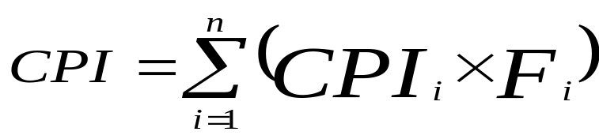
Instruction Frequency & CPI
Given a program with n types or classes of instructions with the following characteristics:
C_{i} = Count of instructions of type_{i} executed
CPI_{i} = Average cycles per instruction of type_{i}
F_{i} = Frequency or fraction of instruction type_{i} executed
= C_{i}/ total executed instruction count = C_{i}/ I
Then:
i = 1, 2, …. n
Where: Executed Instruction Count I = Σ C_{i}
i.e average or effective CPI
CPI_{i} x F_{i}
Fraction of total execution time for instructions of type i =
CPI
T = I x CPI x C

Slide 35
Instruction Type Frequency & CPI:
A RISC Example
CPI_{i} x F_{i}
Program Profile or Executed Instructions Mix
CPI
Depends on CPU Design
Base Machine (Reg / Reg)
Op Freq, F_{i} CPI_{i} CPI_{i} x F_{i} % Time
ALU 50% 1 .5 23% = .5/2.2
Load 20% 5 1.0 45% = 1/2.2
Store 10% 3 .3 14% = .3/2.2
Branch 20% 2 .4 18% = .4/2.2
Given
Sum = 2.2
Typical Mix
i.e average or effective CPI
CPI = .5 x 1 + .2 x 5 + .1 x 3 + .2 x 2 = 2.2
= .5 + 1 + .3 + .4
T = I x CPI x C

Slide 36
Computer Performance Measures :
MIPS (Million Instructions Per Second) Rating
For a specific program running on a specific CPU the MIPS rating is a measure of how many millions of instructions are executed per second:
MIPS Rating = Instruction count / (Execution Time x 10⁶)
= Instruction count / (CPU clocks x Cycle time x 10⁶)
= (Instruction count x Clock rate) / (Instruction count x CPI x 10⁶)
= Clock rate / (CPI x 10⁶)
Major problem with MIPS rating: As shown above the MIPS rating does not account for the count of instructions executed (I).
  A higher MIPS rating in many cases may not mean higher performance or better execution time. i.e. due to compiler design variations.
In addition the MIPS rating:
  Does not account for the instruction set architecture (ISA) used.
    Thus it cannot be used to compare computers/CPUs with different instruction sets.
  Easy to abuse: Program used to get the MIPS rating is often omitted.
    Often the Peak MIPS rating is provided for a given CPU which is obtained using a program comprised entirely of instructions with the lowest CPI for the given CPU design which does not represent real programs.
T = I x CPI x C

Slide 37
Computer Performance Measures :
MIPS (Million Instructions Per Second) Rating
Under what conditions can the MIPS rating be used to compare performance of different CPUs?
The MIPS rating is only valid to compare the performance of different CPUs provided that the following conditions are satisfied:
  The same program is used
  (actually this applies to all performance metrics)
  The same ISA is used
  The same compiler is used
  (Thus the resulting programs used to run on the CPUs and obtain the MIPS rating are identical at the machine code level including the same instruction count)
(binary)

Slide 38
Compiler Variations, MIPS & Performance:
An Example
For a machine (CPU) with instruction classes:
For a given high-level language program, two compilers produced the following executed instruction counts:
The machine is assumed to run at a clock rate of 100 MHz.
Instruction class CPI
A 1
B 2
C 3
Instruction counts (in millions)
for each instruction class
Code from: A B C
Compiler 1 5 1 1
Compiler 2 10 1 1

Slide 39

Compiler Variations, MIPS & Performance:
An Example (Continued)
MIPS = Clock rate / (CPI x 10⁶) = 100 MHz / (CPI x 10⁶)
CPI = CPU execution cycles / Instructions count
CPU time = Instruction count x CPI / Clock rate
For compiler 1:
  CPI₁ = (5 x 1 + 1 x 2 + 1 x 3) / (5 + 1 + 1) = 10 / 7 = 1.428
  MIPS Rating₁ = 100 / (1.428 x 10⁶) = 70.0 MIPS
  CPU time₁ = ((5 + 1 + 1) x 10⁶ x 1.428) / (100 x 10⁶) = 0.10 seconds
For compiler 2:
  CPI₂ = (10 x 1 + 1 x 2 + 1 x 3) / (10 + 1 + 1) = 15 / 12 = 1.25
  MIPS Rating₂ = 100 / (1.25 x 10⁶) = 80.0 MIPS
  CPU time₂ = ((10 + 1 + 1) x 10⁶ x 1.25) / (100 x 10⁶) = 0.15 seconds
MIPS rating indicates that compiler 2 is better
while in reality the code produced by compiler 1 is faster

Slide 40
Computer Performance Measures :
MFLOPS (Million FLOating-Point Operations Per Second)
A floating-point operation is an addition, subtraction, multiplication, or division operation applied to numbers represented by a single or a double precision floating-point representation.
MFLOPS, for a specific program running on a specific computer, is a measure of millions of floating point-operation (megaflops) per second:
MFLOPS = Number of floating-point operations / (Execution time x 10⁶ )
MFLOPS rating is a better comparison measure between different machines (applies even if ISAs are different) than the MIPS rating.
  Applicable even if ISAs are different
Program-dependent: Different programs have different percentages of floating-point operations present. i.e compilers have no floating- point operations and yield a MFLOPS rating of zero.
Dependent on the type of floating-point operations present in the program.
  Peak MFLOPS rating for a CPU: Obtained using a program comprised entirely of the simplest floating point instructions (with the lowest CPI) for the given CPU design which does not represent real floating point programs.

Slide 41
Quantitative Principles of Computer Design
Amdahl’s Law:
The performance gain from improving some portion of a computer is calculated by:
Speedup = Performance for entire task using the enhancement
Performance for the entire task without using the enhancement
or Speedup = Execution time without the enhancement
Execution time for entire task using the enhancement
i.e using some enhancement
Here: Task = Program
Recall: Performance = 1 /Execution Time

Slide 42
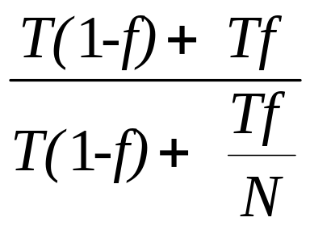
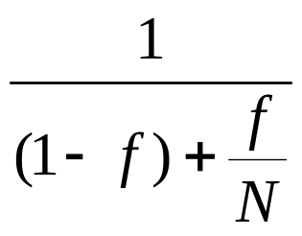
Performance Enhancement Calculations:
Amdahl's Law
Amdahl’s Law:
Execution Time without enhancement
Speedup(E) =
Execution Time with enhancement
Suppose a program contains s portion of code which requires sequential execution and and f portion of code can run in parallel fashion.
We can write as s=1-f
Suppose T be the execution time of program using single processor
So, T= T(1-f)+ Tf
If n processor will be used,
So, T= T(1-f)+ Tf / N
Speedup = =

Slide 43
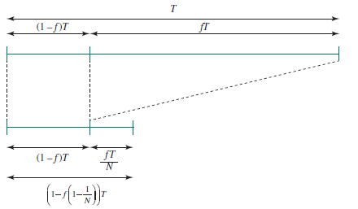
Pictorial Depiction of Amdahl’s Law
Illustration of Amdahl’s Law [5]

Slide 44
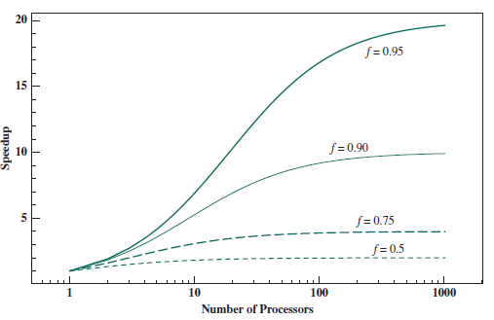
Amdahl’s Law for Multiprocessors [5]

Slide 45
Example
Suppose that a task makes extensive use of floating-point operations, with 40% of the time consumed by floating-point operations. With a new hardware design, the floating-point module is speed up by a factor of 4. Find overall Speedup?
Solution: Floating point operation= 0.4
Non floating point operation = 1-0.4=0.6
Speedup = 1/ (0.6+0.4/4) =1.42

Slide 46
Performance Enhancement Example
For the RISC machine with the following instruction mix given earlier:
    OP Freq Cycles CPI(i) % Time
    ALU 50% 1 .5 23%
    Load 20% 5 1.0 45%
    Store 10% 3 .3 14%
  Branch 20% 2 .4 18%
If a CPU design enhancement improves the CPI of load instructions from 5 to 2, what is the resulting performance improvement from this enhancement:
Fraction enhanced = F = 45% or .45
Unaffected fraction = 1- F = 100% - 45% = 55% or .55
Factor of enhancement = S = 5/2 = 2.5
Using Amdahl’s Law:
1 1
Speedup(E) = ------------------ = --------------------- = 1.37
(1 - F) + F/S .55 + .45/2.5
CPI_{i} x F_{i}
CPI
CPI = 2.2

Slide 47
An Alternative Solution Using CPU Equation
    Op Freq Cycles CPI(i) % Time
    ALU 50% 1 .5 23%
    Load 20% 5 1.0 45%
    Store 10% 3 .3 14%
  Branch 20% 2 .4 18%
If a CPU design enhancement improves the CPI of load instructions from 5 to 2, what is the resulting performance improvement from this enhancement:
Old CPI = 2.2
New CPI = .5 x 1 + .2 x 2 + .1 x 3 + .2 x 2 = 1.6
Original Execution Time Instruction count x old CPI x clock cycle
Speedup(E) = ----------------------------------- = ----------------------------------------------------------------
New Execution Time Instruction count x new CPI x clock cycle
old CPI 2.2
= ------------ = --------- = 1.37
new CPI 1.6
Which is the same speedup obtained from Amdahl’s Law in the first solution.
CPI = 2.2
New CPI of load is now 2 instead of 5
T = I x CPI x C

Slide 48
Performance Enhancement Example
A program runs in 100 seconds on a machine with multiply operations responsible for 80 seconds of this time. By how much must the speed of multiplication be improved to make the program four times faster?
Hence multiplication should be 16 times
faster to get an overall speedup of 4.
1 1 1
Speedup(E) = ------------------ = 4 = ----------------- = ---------------
(1 - F) + F/S (1 - .8) + .8/S .2 + .8/s
Solving for S gives S= 16
Machine = CPU

Slide 49
Performance Enhancement Example
For the previous example with a program running in 100 seconds on a machine with multiply operations responsible for 80 seconds of this time. By how much must the speed of multiplication be improved to make the program five times faster?
Speedup= 1 / (0.2 + (0.8/K))
5=1 / (0.2 + (0.8/K))
K+4 =K
4=0
No amount of multiplication speed improvement can achieve this.

Slide 50
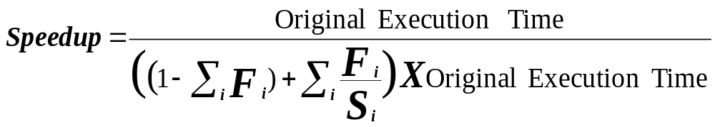
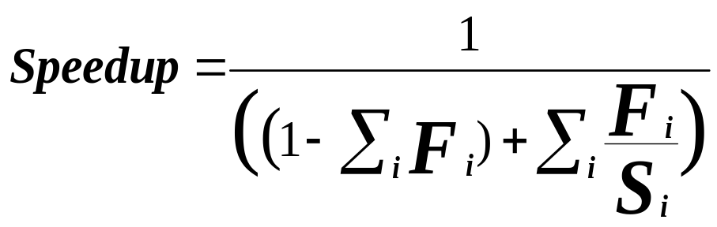
Extending Amdahl's Law To Multiple Enhancements
n enhancements each affecting a different portion of execution time
Suppose that enhancement E_{i} accelerates a fraction F_{i} of the original execution time by a factor S_{i} and the remainder of the time is unaffected then:
i = 1, 2, …. n
Unaffected fraction
What if the fractions given are
after the enhancements were applied?
How would you solve the problem?
(i.e find expression for speedup)
Note: All fractions F_{i} refer to original execution time before the
enhancements are applied.

Slide 51
Amdahl's Law With Multiple Enhancements: Example
Three CPU performance enhancements are proposed with the following speedups and percentage of the code execution time affected:
Speedup₁ = S₁ = 10 Percentage₁ = F₁ = 20%
Speedup₂ = S₂ = 15 Percentage₁ = F₂ = 15%
Speedup₃ = S₃ = 30 Percentage₁ = F₃ = 10%
While all three enhancements are in place in the new design, each enhancement affects a different portion of the code and only one enhancement can be used at a time.
What is the resulting overall speedup?
Speedup = 1 / [(1 - .2 - .15 - .1) + .2/10 + .15/15 + .1/30)]
= 1 / [ .55 + .0333 ]
= 1 / .5833 = 1.71

Slide 52
Pictorial Depiction of Example
Before:
Execution Time with no enhancements: 1
i.e normalized to 1
S₁ = 10
S₂ = 15
S₃ = 30
Unaffected, fraction: .55
F₁ = .2
F₂ = .15
F₃ = .1
/ 10
/ 15
/ 30
Unchanged
Unaffected, fraction: .55
After:
Execution Time with enhancements: .55 + .02 + .01 + .00333 = .5833
Speedup = 1 / .5833 = 1.71
Note: All fractions F_{i} refer to original execution time.
What if the fractions given are
after the enhancements were applied?
How would you solve the problem?

Slide 53
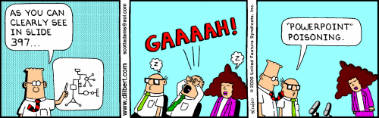
That’s all for now…

Slide 54
References
[1]. Cramming more components onto integrated circuits, Reprinted from Electronics, volume 38, number 8, April 19, 1965, pp.114 ff.
[2]. https://www.top500.org/lists/top500/2020/06/highs
[3]. M Morris R. Mano, “Computer System Architecture”, 3rd edition, Pearson Education
[4] Computer Organization and Design THE HARDWARE / SOFTWAREINTERFACE David A. Patterson University of California, Berkeley John L. Hennessy Stanford University
[5] Computer Organization and Architecture Designing for Performance Tenth Edition William Stallings

